Slide 1

Note: The data and information in this document is reflective of a hypothetical situation and client. This document is to be used for KPMG Virtual Internship purposes only.
Sprocket Central Pty Ltd
Data analytics approach
[Foby Pearl]

Slide 2
Note: The data and information in this document is reflective of a hypothetical situation and client. This document is to be used for KPMG Virtual Internship purposes only.
Agenda
Introduction
Data Exploration
Model Development
Interpretation

Slide 3
Note: The data and information in this document is reflective of a hypothetical situation and client. This document is to be used for KPMG Virtual Internship purposes only.
Introduction
Analysis and recommendation of the top 1000 Customers to target from the given dataset.
Statement of Problem
Sprocket Central is a company that specializes in the sales of high quality bikes and accessories. Their marketing team is looking to boost sales by analyzing the customer & transaction data.
Research Aim
The aim of this analysis is to identify and recommend the top 1000 customers to target to boost the company’s revenue.
Wealth segmentation by Age category
Bike purchase over the past 3years by gender
Job industry distribution
Number of cars owned and not owned in the state
RFM Analysis and customer distribution.

Slide 4
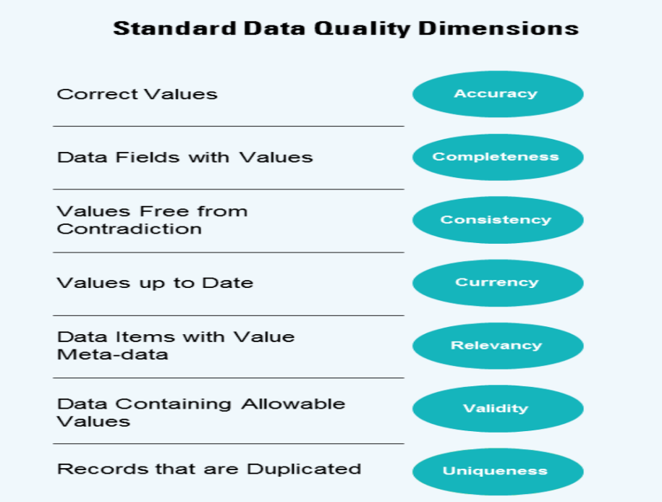
Note: The data and information in this document is reflective of a hypothetical situation and client. This document is to be used for KPMG Virtual Internship purposes only.
Data Exploration
Data Quality Assessment and Clean Up.
Summary of the Data Quality Assessment.
Key Findings
Some of the columns contains blank cells
There was a cell in the DOB column that contained inaccurate data
There was an irrelevant column in the customer demographic dataset
Some of the data were inconsistent
The price column was in a wrong format

Slide 5
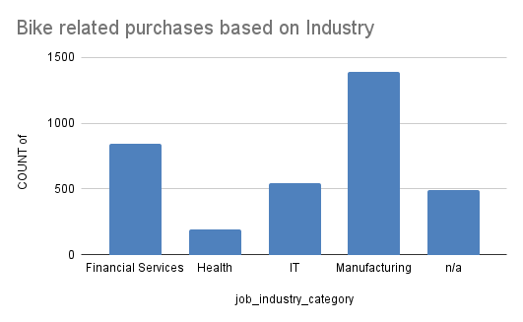
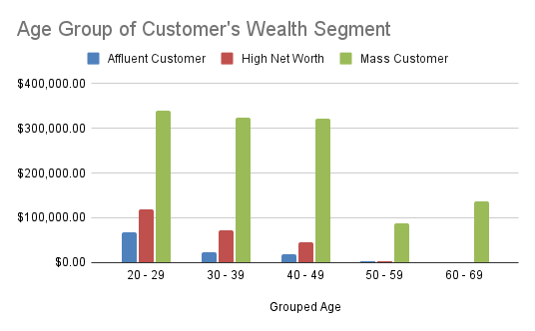
Note: The data and information in this document is reflective of a hypothetical situation and client. This document is to be used for KPMG Virtual Internship purposes only.
Data Exploration
Insights Generated.
It shows that Customers that works in Manufacturing industries purchase the highest amount of bikes.
ii. Customers within 20-29 age bracket within the Wealth segment generates more revenue for the company

Slide 6
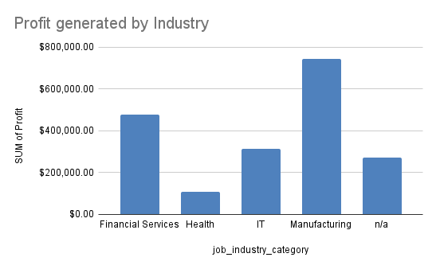
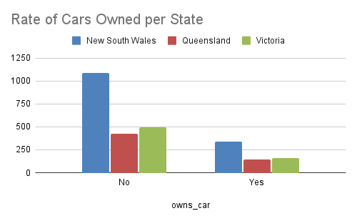
Note: The data and information in this document is reflective of a hypothetical situation and client. This document is to be used for KPMG Virtual Internship purposes only.
Data Exploration
Insights Generated.
It shows that Customers that works in Manufacturing industries generates the highest amount of revenue
Majority of the customers do not own a car
Majority of the Customers resides in New south wales

Slide 7
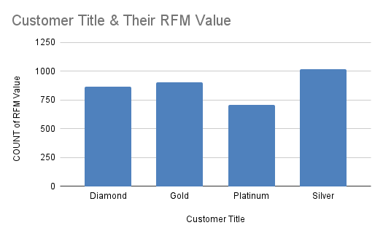
Note: The data and information in this document is reflective of a hypothetical situation and client. This document is to be used for KPMG Virtual Internship purposes only.
Model Development
RFM Analysis & Customer Classification.
The RFM(Recency, Frequency, Monetary) model shows customers with high level of engagement with the business in the above categories mentioned
The RFM Analysis is used to determine which customers a company/business should target to boost their revenue and value.

Slide 8
Note: The data and information in this document is reflective of a hypothetical situation and client. This document is to be used for KPMG Virtual Internship purposes only.
Interpretation
Recommendation.
After carrying out the analysis on the three dataset provided and generated various insights that was helpful to our research, I discovered that the top 1000 customers are those that have purchased bikes recently, frequently and generated more revenue for the company.

Slide 9
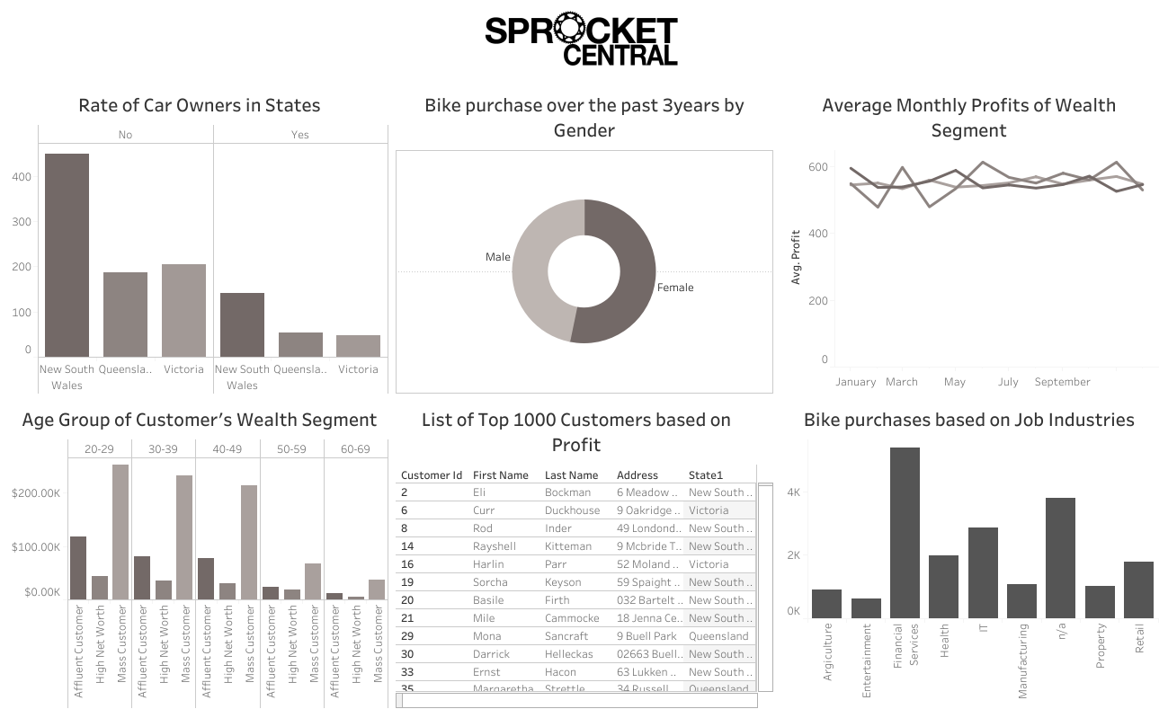

Slide 10
Note: The data and information in this document is reflective of a hypothetical situation and client. This document is to be used for KPMG Virtual Internship purposes only.
Appendix

